Slide 1

Antisaccade Task Performance of Schizophrenia Patients
Michael Popa
Rice University
NEUR 416
Notes:
Paper by Cutsuridis et. al from 2014

Slide 2
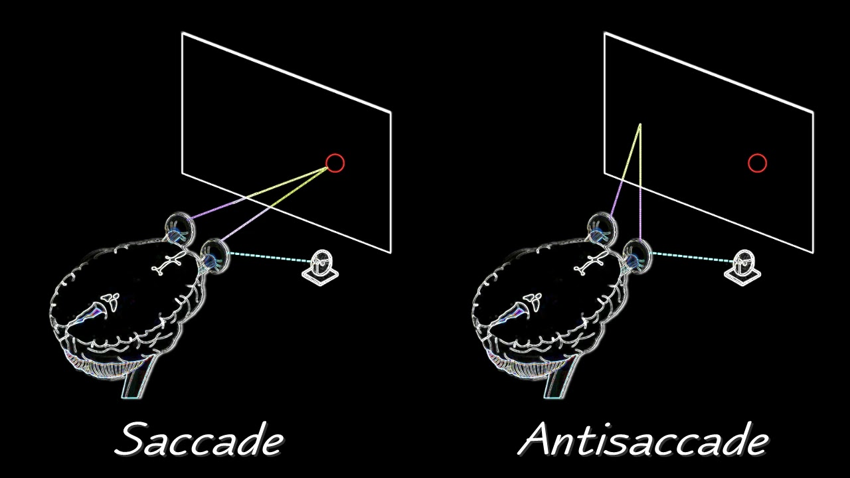

The Antisaccade Task
Notes:
To start off, it’s important to explain what exactly a saccade and antisaccade is. A saccade is simply a rapid eye movement between fixation points. We do them pretty much all the time, and it’s usually involuntary. An antisaccade on the other hand is when you try to inhibit a saccade from happening.
So, in an antisaccade task, you have a participant looking at a fixation point in the middle of the screen, and there’s a flashing dot that appears in the periphery of the fixation point. Naturally, your eyes want to saccade to that flashing dot, but in the antisaccade task, you try to look in the opposite direction equidistant to the fixation point.
This reason this task is useful is because it helps us study the cognitive control and inhibitory processes in both healthy individuals as well as those with psychiatric disorders.

Slide 3
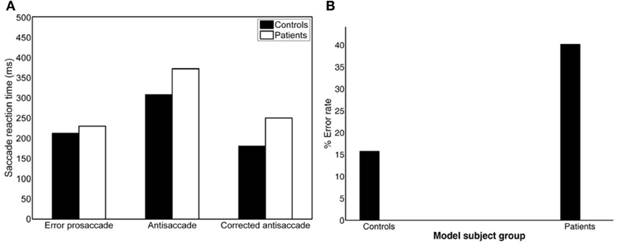
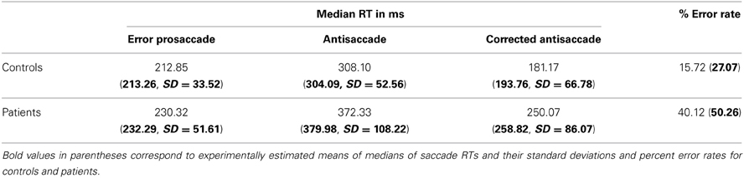
Performance in Schizophrenia Patients
(Cutsuridis et. al., 2014)
Notes:
So, when we look at patients with schizophrenia, we can see that they perform significantly worse on the antisaccade task when compared to a control group. Their error rates are much higher, meaning that they make a higher number of regular saccades instead of antisaccades. Also, the time it takes for a patient to make an eye movement is much higher for saccades and antisaccades, as well as the time it takes for a patient to correct their saccade into an antisaccade. Overall, they have more errors and have worse reaction times than the control group.
So naturally, the question now is now why is their performance so much worse compared to the control group?

Slide 4
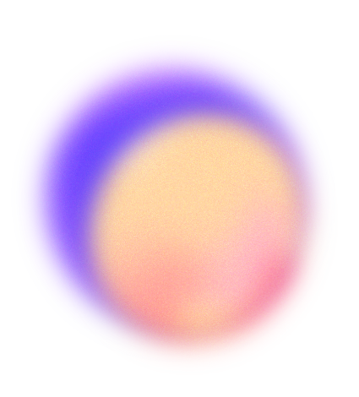

Two Theories
One
Two
A third top-down inhibitory signal
Competition between prosaccade and antisaccade neurons
(Noorani and Carpenter, 2013)
(Cutsuridis et. al., 2014)
Notes:
So, there are two big theories that the paper mentions. The first one talks about there being some third top-down inhibitory signal that fails to suppress the saccade from occurring. The second one is that there is competition between erroneous prosaccade neurons and correct antisaccade neurons.
The model that I looked at focuses on the second theory, reason being that a study by Noorani and Carpenter from 2013 attempted to create a model using the first theory in mind, and it turns out that it struggled at replicating the latency distributions. So now the question is, will a model with the second theory be more efficient.

Slide 5
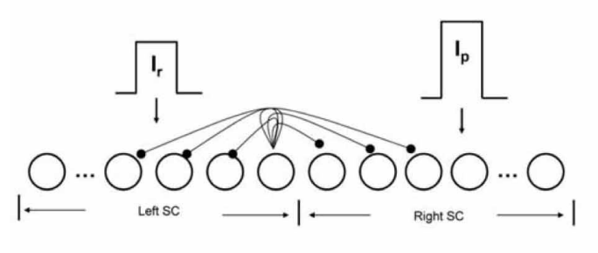
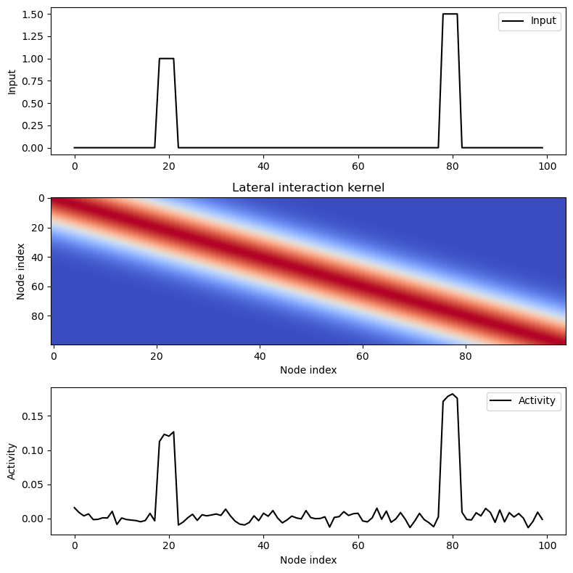
Implementation
Notes:
The model is a competitive neural network that is meant to represent neurons in the superior colliculus, a part of our midbrain that is known to be responsible in eye movement. There are 100 neurons in the network that are split into two halves, the first half represents the left superior colliculus and the right half represents the right superior colliculus.
One node in the left half, specifically node 20, as well as its four nearest neighbors (so nodes 18,19,21, and 22) represent the neurons influenced by the reactive input Ir. In other words, these would be the neurons responsible for an error prosaccade.
On the other half, another node, specifically node 80, as well as its four nearest neighbors (nodes 78, 79, 81 and 82), represent the neurons influenced by the planned input Ip. These would be the neurons that are responsible for a correct antisaccade. Anatomically, it would mean that the left SC neurons are influenced by the posterior parietal cortices and the right SC neurons are influenced by the frontal cortex.
And it’s also important to note that the planned input is more powerful than the reactive input, specifically one and a half times more powerful.

Slide 6
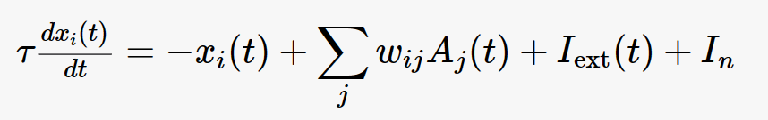
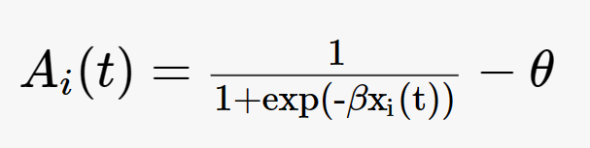
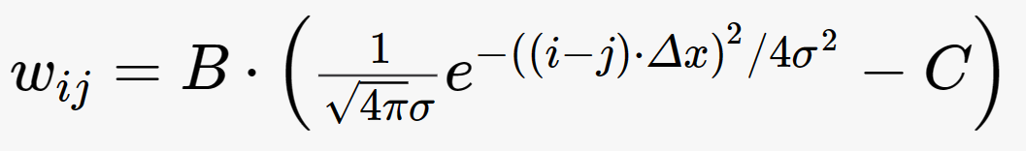
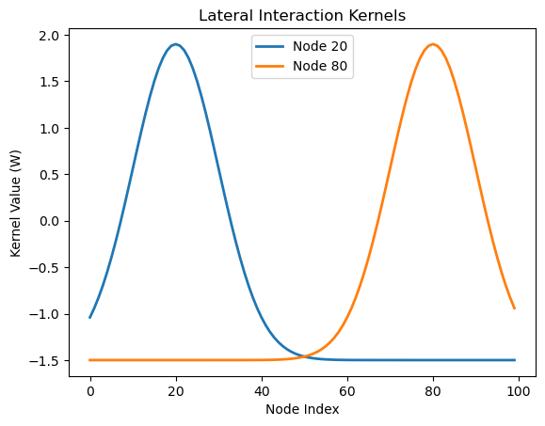
Notes:
The internal state for each neuron is governed by this dynamical system, where our activation function A(t) represents the average membrane potential and is a sigmoid function, and wij is the lateral interaction kernel that only allows interactions between nodes in the same colliculus and between nodes in the opposite colliculi.
W_ij is chosen to be a shifted Gaussian that depends only on the spatial distance between nodes. So it is positive for nearby nodes and negative for distant nodes.
I_ext is our external input, and as mentioned before, it becomes either the reactive input (Ir) or the planned input (Ip) depending on which side of the neural network it is on.
Tau is also very important here since it is also drawn from a Gaussian distribution with different means and standard deviations depending on which half of the neural network it is influencing.

Slide 7
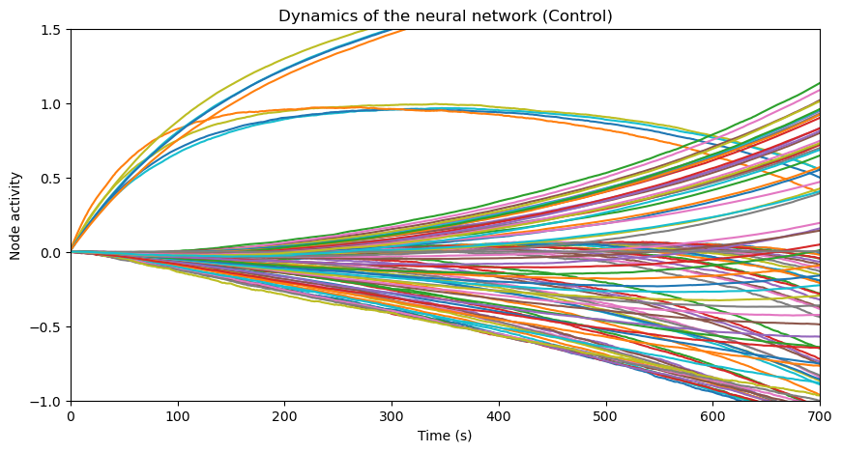
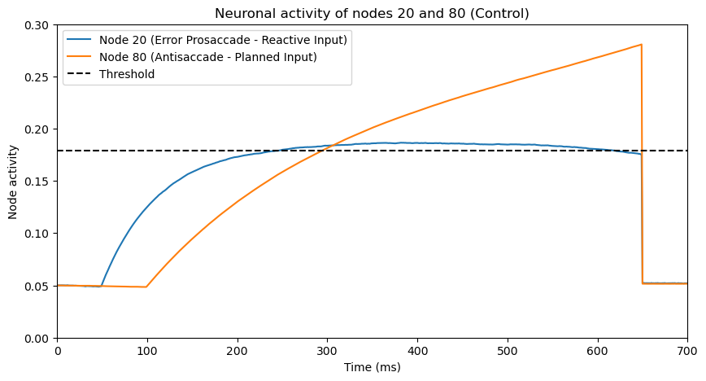
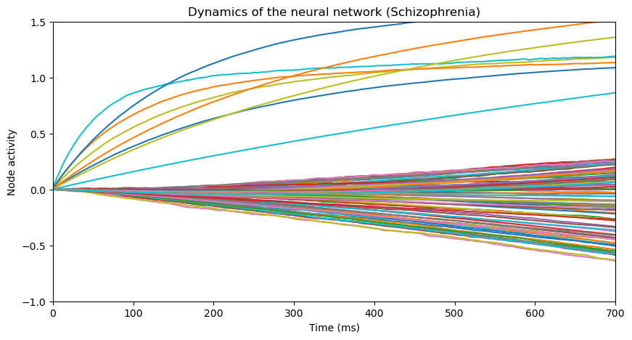
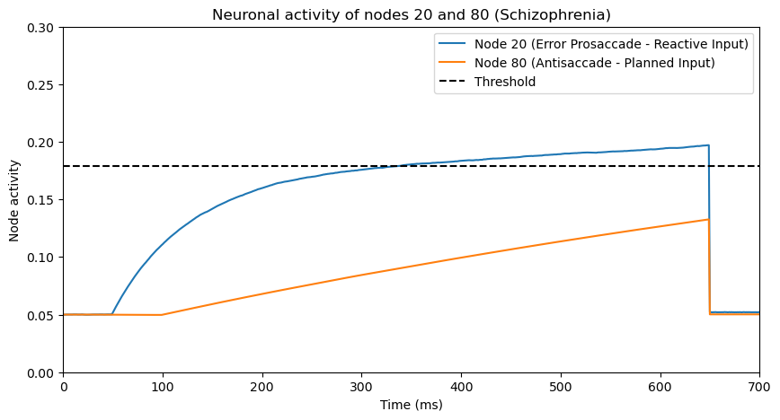
Notes:
When we plot the dynamics of our network, we can already see how the neuron’s activity vary and change over time.
If we look at the control group, it’s pretty easy to differentiate between the groups of neurons. You can tell which group of neurons are reactive and which are planned since we know that the reactive neurons are weaker than the planned neurons.
However, in the schizophrenia condition, you can’t really tell which is which. It is much more noisy and variable in its output, and it’s hard to tell which neurons are reactive or planned.
When we zoom in and look at individual trials, we can get a better idea of how this model works. It is a rise-to-threshold model, meaning that whichever neuron reaches the threshold first will be the one that causes either a saccade or antisaccade. In this case, the top right represents an erroneous saccade occurring first, followed quickly by a correction when node 80 hits the threshold soon after. Meanwhile, the bottom right represents an erroneous prosaccade occurring without any sort of correction.

Slide 8
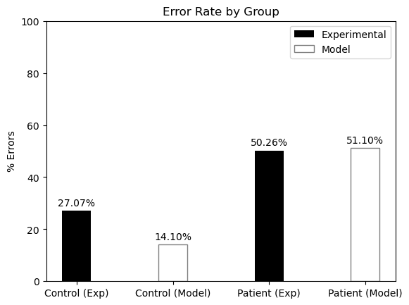
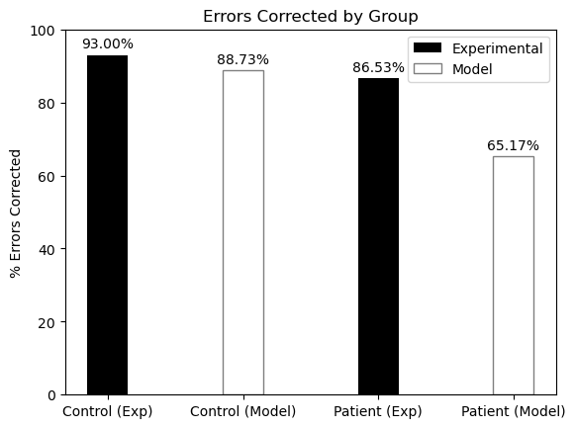
Error Rate and Corrections
Notes:
When we see how the model calculates the error rates and rate of error correction, it does a pretty good job overall at matching the experimental data. When it comes to the error rate, it does really well for the patient, but struggles a bit for the control group. On the flip side however, for the rate of error correction, the model does a great job for the control group, but struggles way more for the patient group. So overall, there is a bit of a limitation of the model in properly replicating the error rates and correction rates, but it does get pretty close.

Slide 9
Reaction Times (ms)
 | Error Prosaccade | Antisaccade | Corrected Antisaccade
Controls
Patients
Notes:
However, when we take a look at the latency distributions, we can see that the model does a pretty good job at getting almost identical numbers to the experimental data. On the bottom table, the values in bold represent the values from the experimental data and the values in the table above represent the ones computed by our model. Overall, the numbers are pretty close, which is exactly what we want to prove our second theory. The latency distributions were accurate enough to tell us that competition between saccade neurons and antisaccade neurons seems to be a more accurate theory for why schizophrenics perform worse on the antisaccade task.

Slide 10
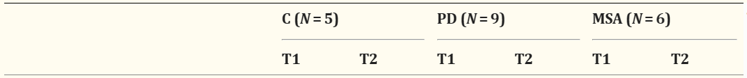
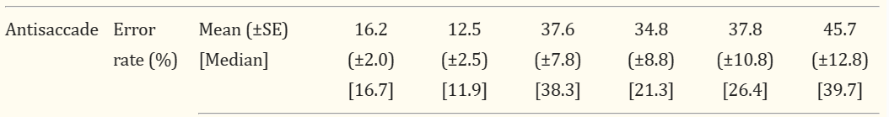
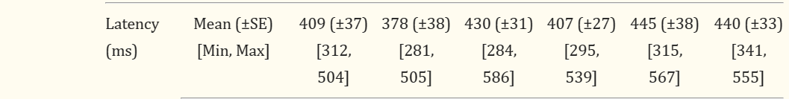
Parkinson’s Disease and Multiple System Atrophy
(Brooks et. al., 2017)
Notes:
As an extension, I found a separate paper that looks at the antisaccade task performance of patients with Parkinson’s Disease and patients with Multiple System Atrophy. They tested the patients on this task at two different time points, T1 being the first test, and T2 being the same test but 7 months later. As you can see, the error rates for those with Parkinson’s remained generally the same after a 7 month period, but for those with MSA, the error rate increases by a pretty high amount. The latency distributions for both disorders decreased, but less for the MSA group. So, my goal was to modify the model and its parameters to get these outputs.

Slide 11
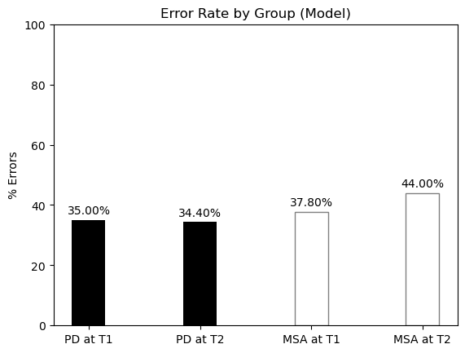
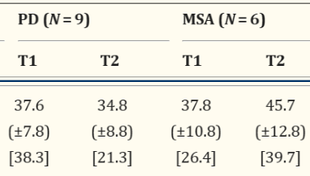
Experimental Data
Notes:
And it turns out that the model does a pretty good job at replicating the error rates on the antisaccade task for both disorders at the differing time points. In order to get the desired PD error percentages, I had to make the saccade neurons less noisy than the schizophrenia patients by decreasing the standard deviation of the reactive input. As for the MSA error percentages, the parameters at T1 were very similar to the PD parameters, but for T2, I focused more on modifying the parameters of the planned input by increasing the standard deviation as well as decreasing the mean used in the Tau distribution.

Slide 12
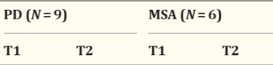
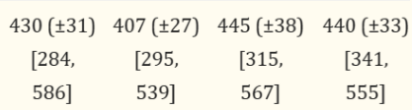
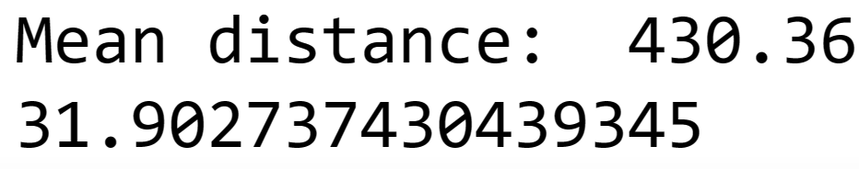
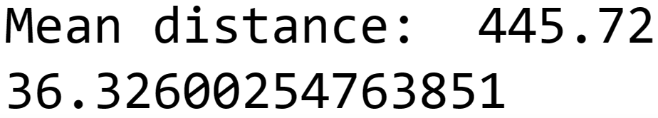
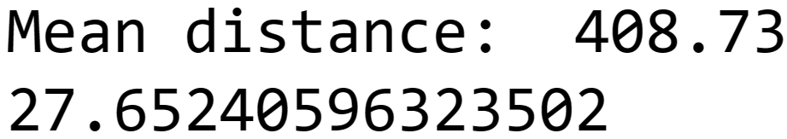
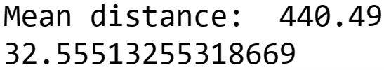
Experimental Data
Model Data
PD at T1:
MSA at T1:
PD at T2:
MSA at T2:
Notes:
Finally, when looking at the latency distributions, the model does a good job at replicating the mean latency distributions as well as the standard deviations associated with each. I did have to slightly change the parameters again to fit the data, which I know isn’t ideal, but overall came pretty close to what we wanted. I do think there has to be further testing when it comes to the parameters since I think that there are way better numbers to choose to fit the experimental data for both the error rates and latency distributions.

Slide 13
Overall Conclusions
Competition between neurons -> ✓
Third inhibitory signal -> ✗
Noisy accumulation of information -> ✓
More research necessary
Notes:
So overall, what this model tells us is that the increased variability in performance of schizophrenics is due to noisy accumulation of information and is not because of their confidence or threshold level. It also does support our second theory that competition between the correct and erroneous decision processes, rather than a third top-down inhibitory signal, accounts for the antisaccade task performance of the patients and control group. However, further research needs to be done on replicating the error rates and rate of error correction between the schizophrenia and control groups.

Slide 14
REFERENCES
Brooks, Sarah H et al. “Slowed Prosaccades and Increased Antisaccade Errors As a Potential Behavioral Biomarker of Multiple System Atrophy.” Frontiers in neurology vol. 8 261. 20 Jun. 2017, doi:10.3389/fneur.2017.00261
Cutsuridis, Vassilis et al. “Antisaccade performance in schizophrenia: a neural model of decision making in the superior colliculus.” Frontiers in neuroscience vol. 8 13. 11 Feb. 2014, doi:10.3389/fnins.2014.00013
Noorani, I, and R H S Carpenter. “Antisaccades as decisions: LATER model predicts latency distributions and error responses.” The European journal of neuroscience vol. 37,2 (2013): 330-8. doi:10.1111/ejn.12025

Slide 15
Thank
You!

